Slide 1
Effects of Floors Climbed on Active Energy Burned
İsmet Tolga Yılmaz / 32032

Slide 2

My Data Set
Apple Health

Slide 3
My Null Hypothesis(H0)
The active energy that I burned
is not corelated with the flights that I climbed

Slide 4
My Alternative Hypothesis(Ha)
The active energy that I burned
is increasing according to the flights that I climbed

Slide 5
Steps
I parsed the data day by day from October 2023 to June 2024 then I grouped them monthly and got averages of them.

Slide 6
Why xml.etree.ElementTree
I used xml.etree.ElementTree library to parse xml files because it is more efficient than beautiful soap at parsing xml files. Since my Apple health data is 1.1 GB xml file I preffered an efficient parser.

Slide 7
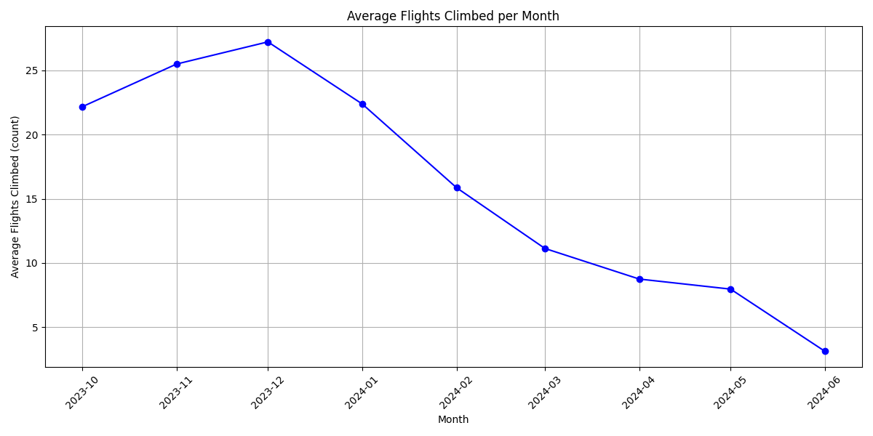
First I started with parsing and visiualizing my monthly flights climbed

Slide 8
I was staying at a 3rd floor dorm last year first term so high numbers of flights climbed was expected.
I was staying at an entrance floor dorm last year second semester so decrease at flights climbed was expected too.

Slide 9
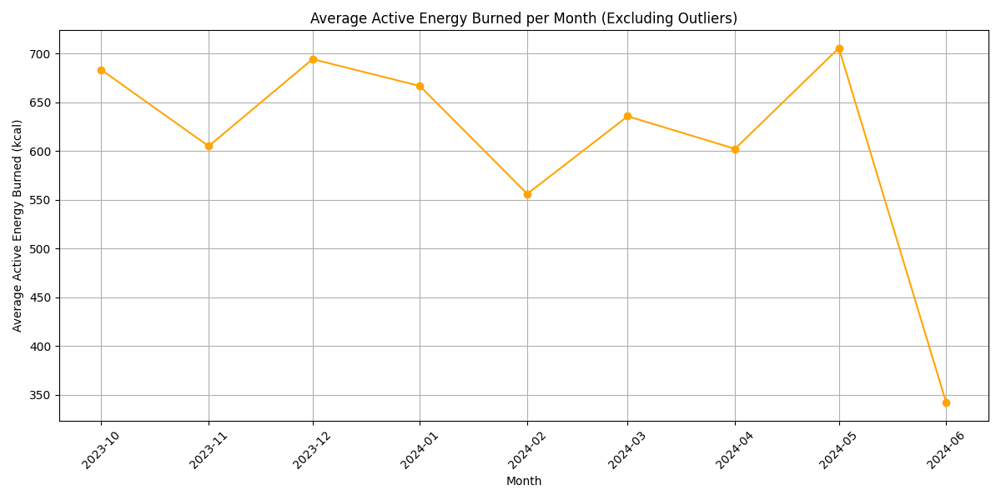
Then I looked for the same thing with active energy burned

Slide 10
At first term I was at 3rd floor so high numbers of active calories burned was an expected outcome
Second term was not expected because instead I was climbing less floors every day I was still burning the same amount of calories.

Slide 11
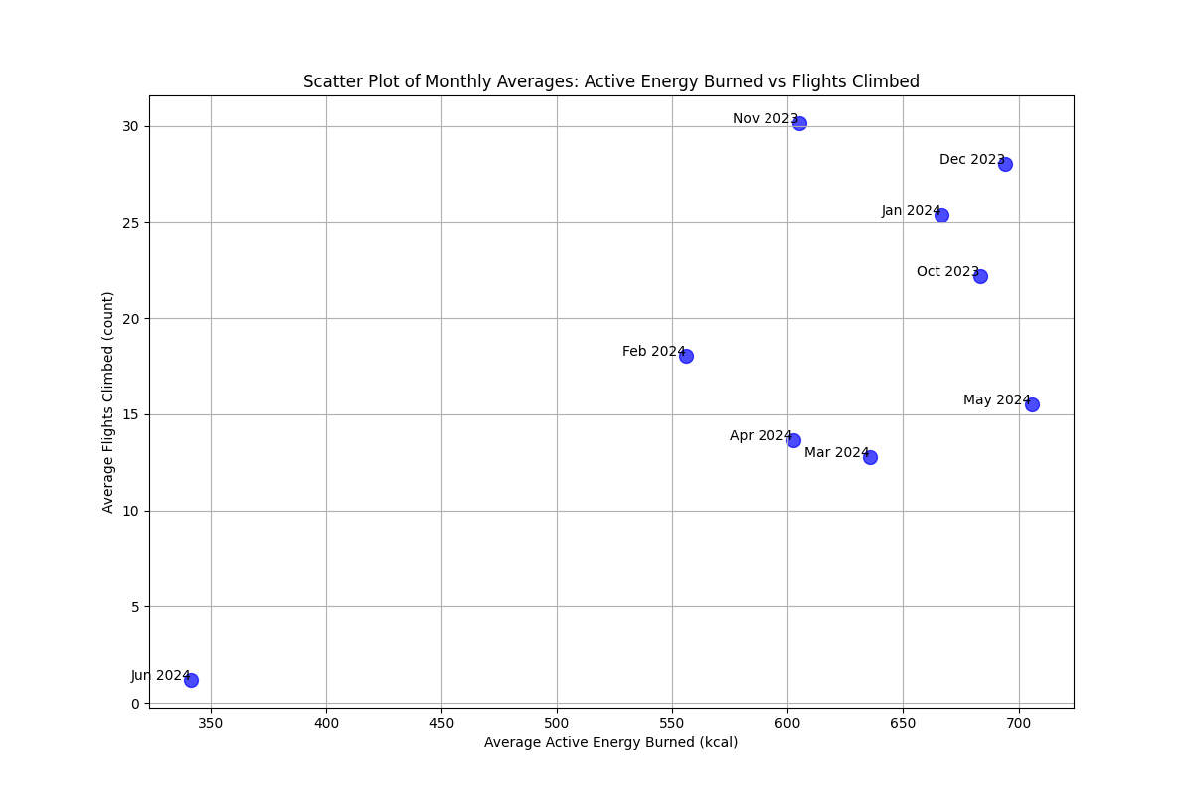
Then I looked at it at scatter plot to find a correlation

Slide 12
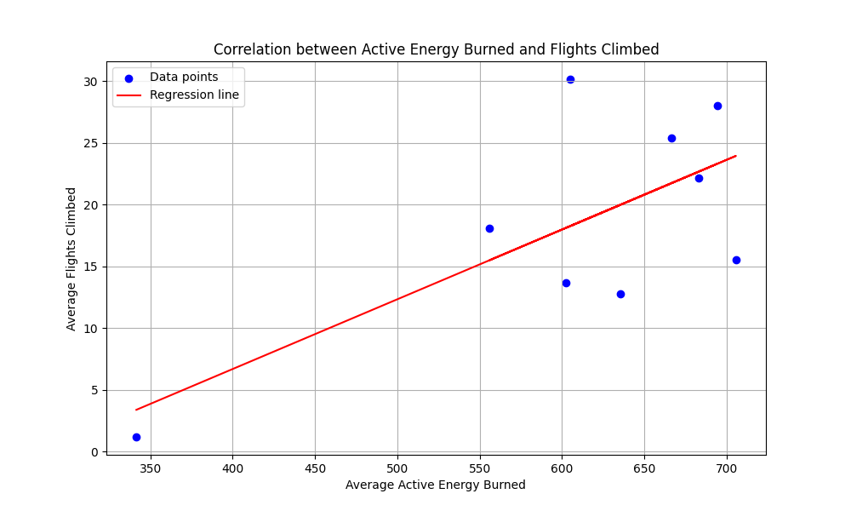
I put a regression line

Slide 13
I found out that p value is 0.035.
This means I am rejecting my null hypothesis.
So we can say that flights that I climbed and the active energy that I burned are correlated with each other.

Slide 14
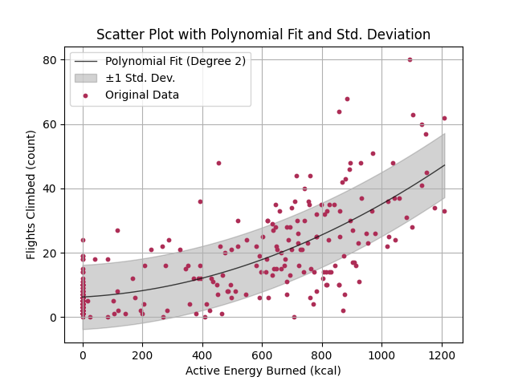
When I checked the same thing day by day

Slide 15
We can see that there is a positive correlation between the flights climbed in a day and active energy burned in a day.

Slide 16
Lastly I tried to use ml to predict the active energy that I burned according to the flights that I climbed

Slide 17
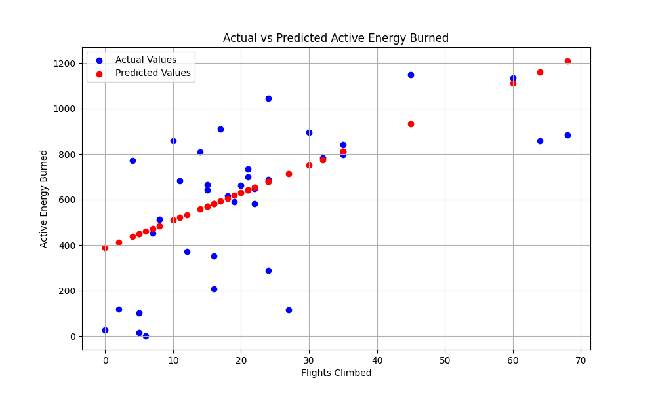
Predictions

Slide 18
Mean Squared Error (MSE): 64491.42
R^2 Score: 0.35

Slide 19
R^2 shows that approximately 35% of the variance in the active energy burned can be explained by the flights climbed.
Mean Squared Error indicates the average squared difference between the actual and predicted active energy burned. A lower value is better.

Slide 20
THANK YOU FOR YOUR TIME

